Slide 1
CS487/587
Project Part III
Mingjue Wang & Brent Daniels-Soles

Slide 2
DBMS Systems - What
We chose to compare:
PostgreSQL
MySQL

Slide 3
DBMS Systems - Why?
PostgreSQL
Not as Popular as MySQL
Open Source
“Battle Tested”
Has a rich feature set
MySQL
More Popular than Postgres
(Kinda) Open Source
There is an Enterprise version, along with Community version.
Has less features, but has all the essentials to build a product

Slide 4
DBMS Systems - Why?
Commonalities
They are both used heavily in industry
They both have a similar syntax/semantics
Given all of the previous points and their similarities, we wanted to see how different they are when it comes to dealing with larger amounts of data.
Our hypothesis was MySQL would do better with smaller amounts of data, and Postgres would perform better with our JOIN tests on large amounts of data.

Slide 5
Benchmark Approach
Goals
Keep systems as ‘vanilla’ as possible
Reason: most people use basic install and then start hacking away
Give each system a large amount of data to sift through
Created a 1,000,000 tuple table to mock this
See how each system performs with JOIN operations
Common, yet expensive
Want to determine which may be the best when heavy/many transactions are involved.
Test each query at least 5 times
In order to get a general idea of average execution time.

Slide 6
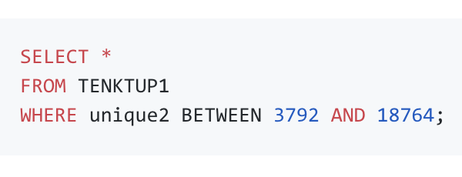
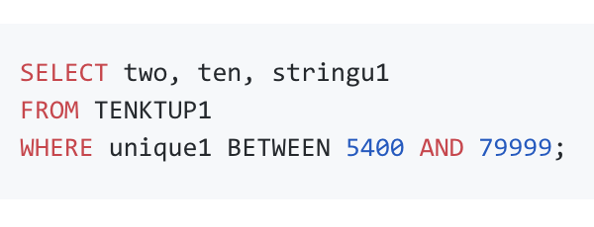
Experiments - Warm Up
Queries ran at the start:
Query 1)
Query 2)

Slide 7
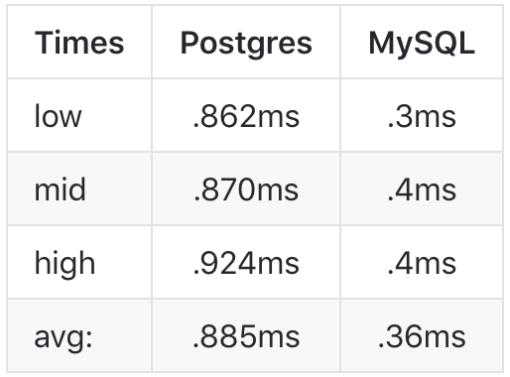
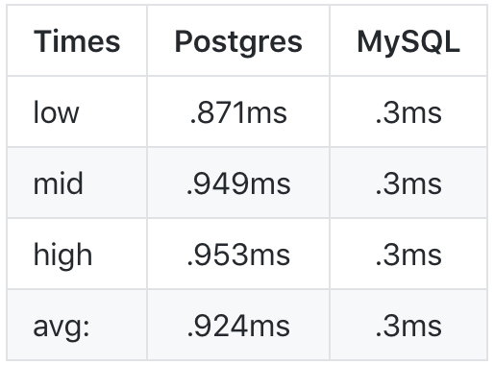
Experiments - Warm Up - Why?
Wanted to get a “baseline” as to how each of these systems perform with scanning tables.
Results:
Query 1)
Query 2)

Slide 8
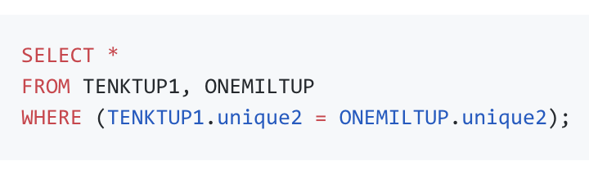
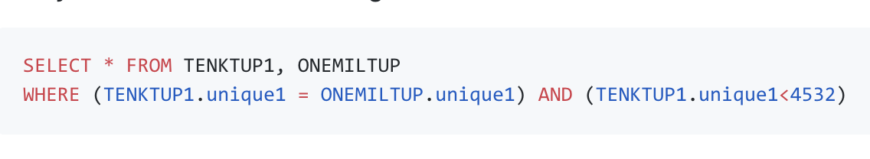
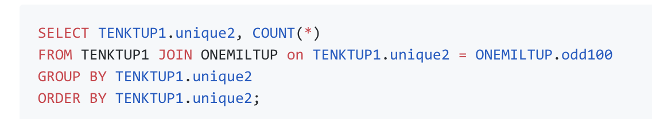
Experiments - JOIN’s
Query 3)
Query 4)
Query 5)

Slide 9
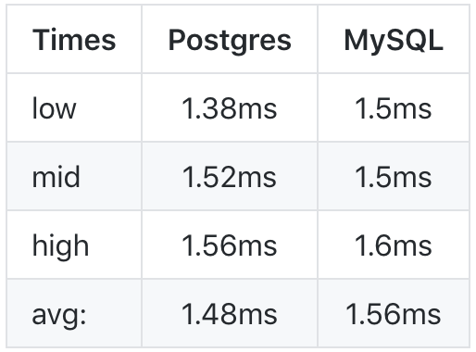
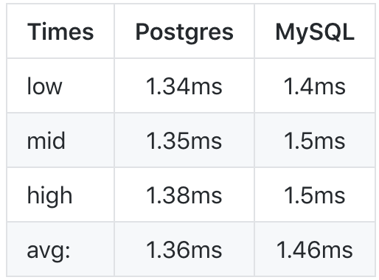
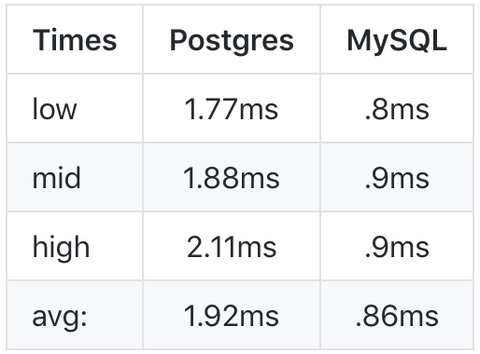
Experiments - JOIN’s - Why?
Since RDBMS’s in production utilize JOIN’s heavily, it would be good to see how each system performs with “production-esque” data.
Results:
Query 3)
Query 4)
Query 5)

Slide 10
Results
Were these expected...?
Kind of…
Expected MySQL to be more performant with simpler queries, and Postgres to perform better with JOIN’s
Reason: MySQL implements only the Nested Loop Join algorithm for JOINS, which is historically slow (there’s a twist)
We were wrong in estimating MySQL would do poorly with JOIN’s
It kept up with Postgres quite well.
Even beat Postgres on the aggregate test.
This is due to MySQL having a “caching layer” called the join_buffer, which stashes away seen rows as the system works through a join, so there is no need to make direct calls to the buffer pool.

Slide 11
Conclusion
From a raw performance standpoint, MySQL keeps up with Postgres
For smaller sets of data, Postgres is relatively slow compared to MySQL
MySQL does have some performance caveautes
i.e. performs slower if large amounts of data aren’t in the join_buffer
For large data sets, the first run of a query can be magnitudes slower than the rest

Slide 12
Lessons Learned
At the end of day, it is about analyzing if a particular DBMS (along with some of the tradeoffs it has) is a good fit for your project.
Both systems have trade-offs
MySQL = query speed inconsistency w/ most being highly performant
Postgres = fairly consistent query speeds, but overall less performant for smaller sets of data
Other systems do as well (e.g. Mongo having no formal JOIN mechanism, yet very easy to get started with; etc....)
Do the due diligence of making sure chosen DBMS is right tool for the job.

Slide 13
Thank you!

